Slide 1
PLM Example
Demonstrates key relationships expressed in the MRM concerning programs, services, service outputs, outcomes, target groups and needs

Slide 2
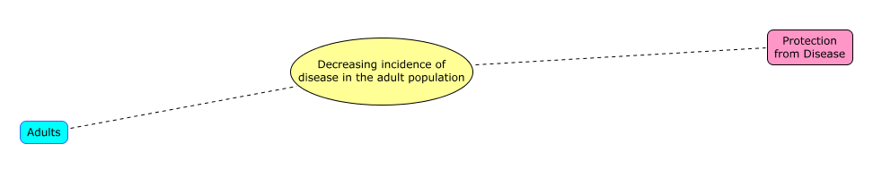
Outcome = a desirable trend in the level of a recognized target group need, resulting from government action
Recognized
Need
Outcome
Target
Group
The government intends a desirable trend. An undesirable trend is typically an unanticipated or accidental outcome.
Notes:
The government’s intent is a desirable trend. An undesirable trend is an unanticipated or accidental outcome.

Slide 3
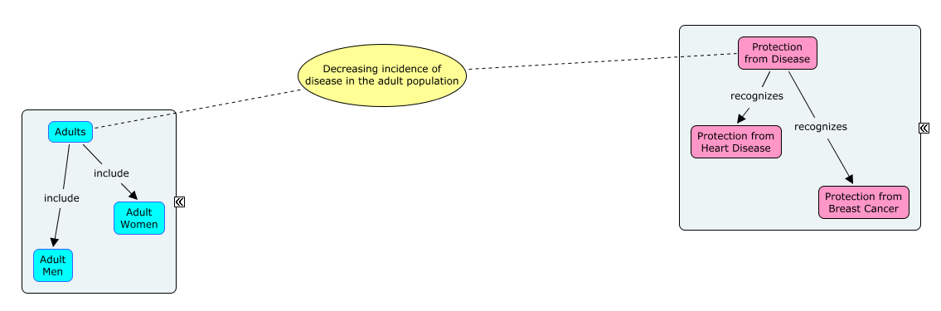
Target groups and recognized needs each form complex hierarchies
Recognized Needs
Model
Target Group
Model
Strictly speaking, target group and needs models form multiple inheritance networks, not hierarchies.
Notes:
Strictly speaking, target group and needs models form multiple inheritance networks, not hierarchies.

Slide 4
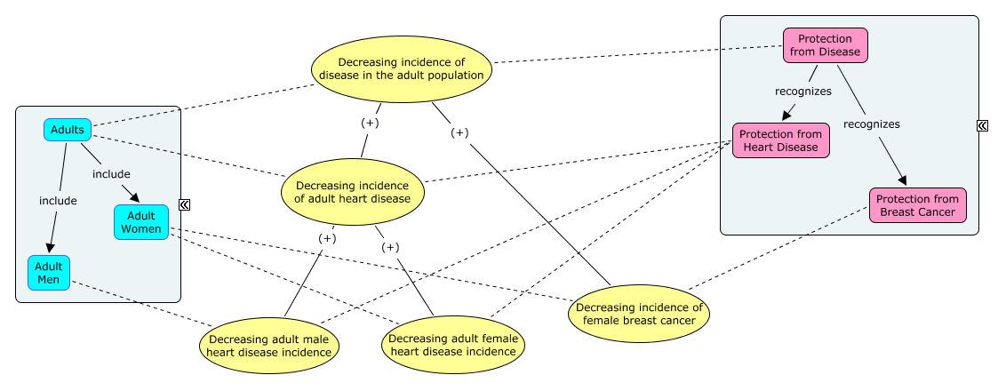
Outcome measures are statistical population measures based on target group and need hierarchies
Some measures are direct and some are proxies. Defining outcomes this way ensures measures can be related to each other.

Slide 5
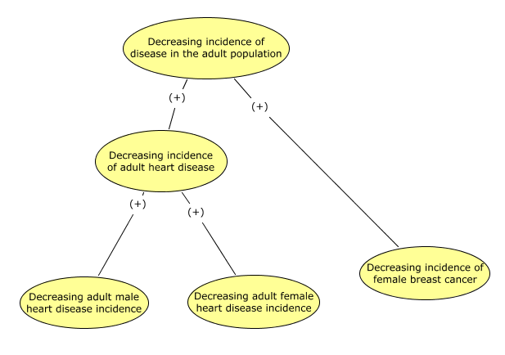
The outcomes hierarchy is the logical heart of the Program Logic Model (PLM)

Slide 6
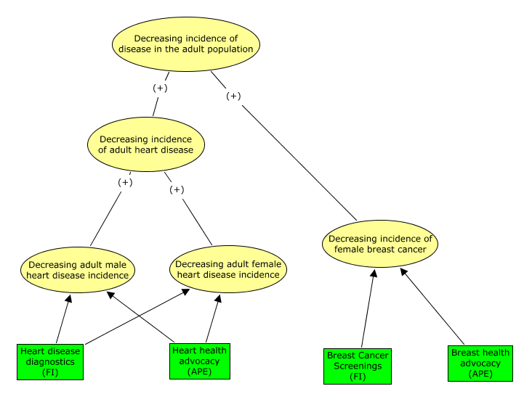
Adding service outputs to the PLM expresses the government’s hypothesis of cause and effect, to be proved (or not) with measures
Services are sometimes shown in the model, but not here for simplicity’s sake and to emphasize the output as the essential cause.
Notes:
Services could be illustrated here, but are not for simplicity’s sake and to emphasize the output as the essential cause.

Slide 7
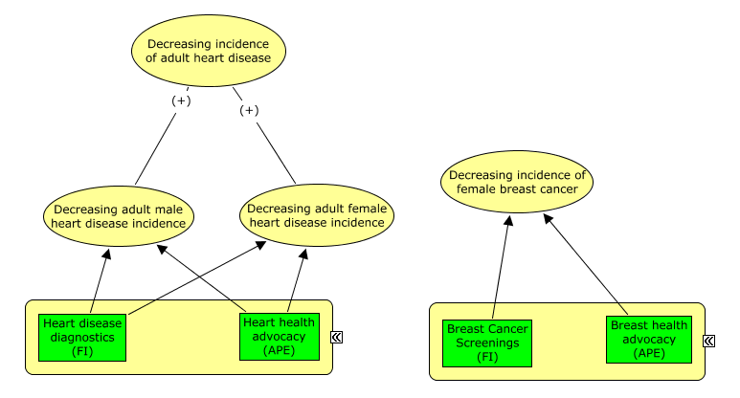
The PLM analyzes the limits of program accountability
Heart Health Program
Breast Health Program

Slide 8
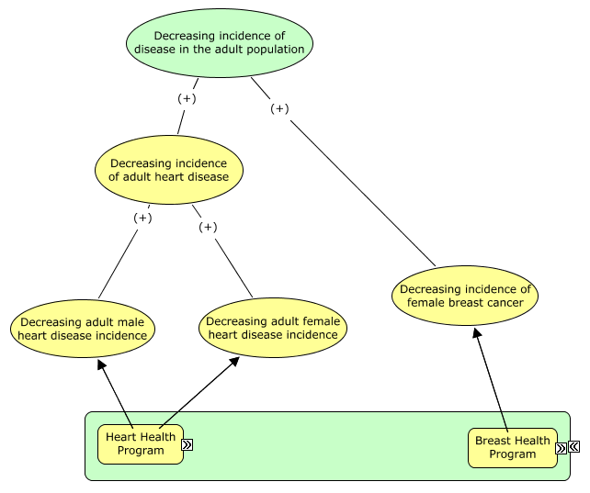
And helps to define program hierarchy…
Public Health Program
Sometimes we need a higher-level program to hold accountability for a higher-level outcome.
Notes:
Sometimes we need a higher-level program to hold accountable for a higher-level outcome.

Slide 9
Target Group Modeling

Slide 10
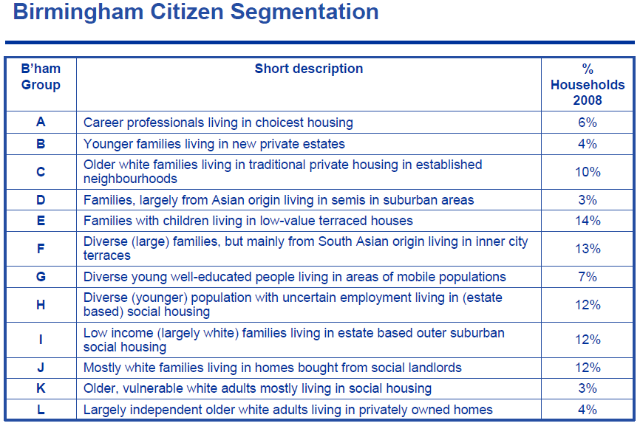
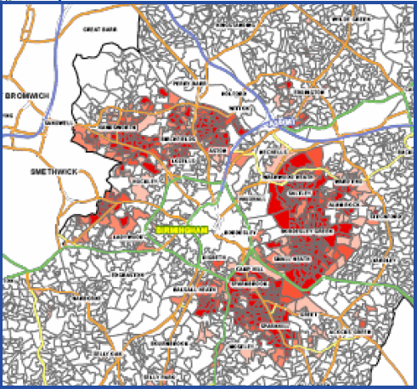
Traditional market segmentation techniques are not applicable to MRM target group definition
This shows an application of the well-known “UK Mosaic” technique to determine what types of services will be needed where
Notes:
This is the application of the well-known “UK Mosaic” technique to determine what types of services will be needed where

Slide 11
Mintzberg proposed four useful roles but not for target group modeling:
Customer – largely commercial transactions, e.g. purchase of information, government assets, etc.
Client – long-term, professional service recipients, e.g. of health care, education, welfare, etc.
Citizen – voter, stakeholder, ‘owner’, e.g. needing identity, protection, etc.
Subject – tax-payer, prisoner, conscript, e.g. compliance and enforcement services
Useful to map services and define engagement strategies but not to segment the jurisdictional population for policy purposes
Notes:
Useful to map services but not to segment population for policy modeling

Slide 12
Service Canada’s segmentation method focuses on human services only
Selection Criteria
Type1 “Issue –driven segmentation”
selection criteria:
captures “All Canadians”
common services that are horizontal such as Identification, Passports etc.
Type 2 “Age-based segments”
selection criteria:
targeted
mutually exclusive
and inclusive
Type 3 “Priority segments”
selection criteria:
Constitutional obligations
targeted populations
require specific government
attention
identified through government
priorities
identified as experiencing
barriers/ providing an
opportunity
To develop strategies that are geared towards specific needs or issues (such as health) and applied to all Canadians, without segmenting the population into more targeted groups.
Issue-driven Segmentation
(e.g. health, environment quality, public safety etc.)
Strategy for Children | Strategy for Youth | Strategy for Working Age Adults | Strategy for Seniors
These segments include 100% of Canadians but the segments are distinct and mutually exclusive from one another. Age-based segments allow GoC to better understand the needs Canadians and integrate its offerings around similarities and trends can be identified within these groups
Children
Youth
Working Age Adults
Seniors
 |  |  | Strategy for Aboriginals
 |  |  | Strategy for Official Language Minorities
 |  |  | Strategy for PWD
 |  |  | Strategy for New Canadians
 |  |  | Strategy for …
These segments include citizens who may require assistance to fully participate in society. Often they are identified through constitutional obligations and/or government priorities.
A starting point for the MRM, but needs to be extended to address gaps, e.g. businesses

Slide 13
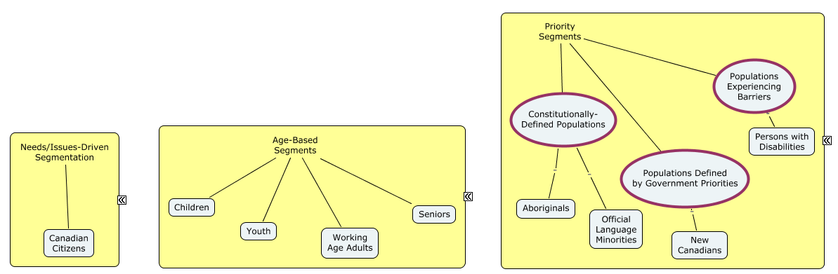
Translating SC’s model to serve as a starting point for the MRM

Slide 14
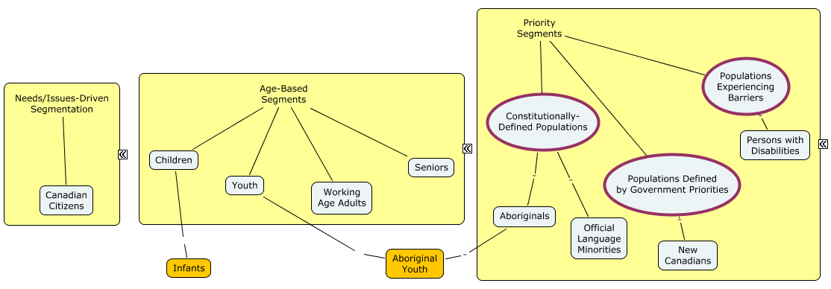
Adding target groups
Target groups would be added as required to fully define programs and services

Slide 15
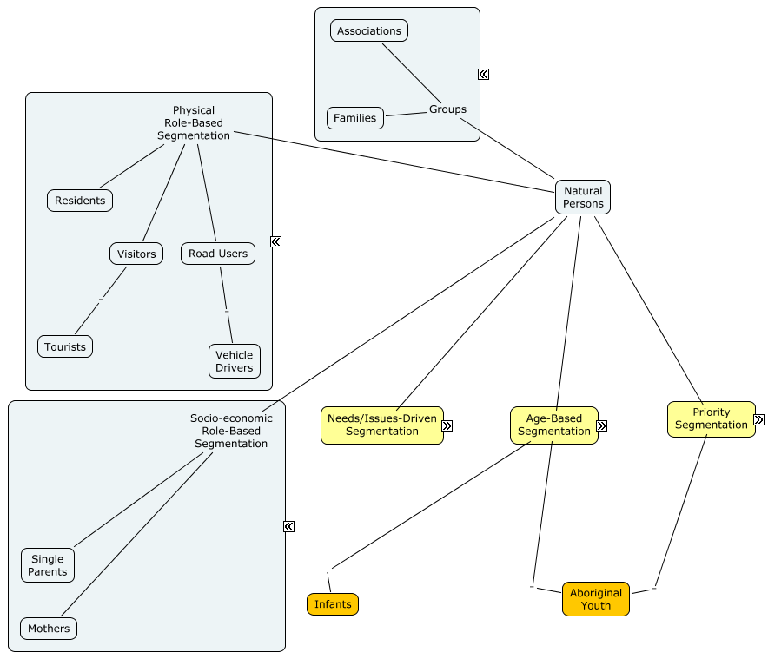
Extending the model’s populations of individuals
This is a preliminary and incomplete picture but illustrates the role the MRM Reference Model can play in providing a standard

Slide 16
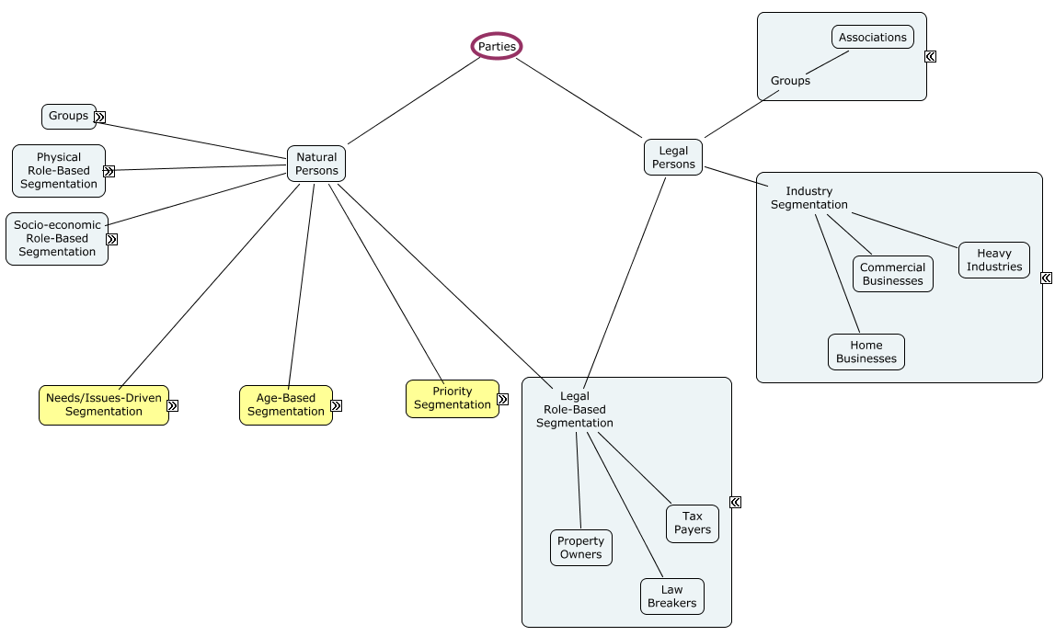
Extending the model’s populations of organizations…
‘Parties’ is the legal concept and serves as the foundation or root of the target group model

Slide 17
Needs Modeling
To come…

